Slide 1

Digitalzone Publications Media Kit
Human Publications. Real Buyers. Smarter Content.

Slide 2





Born from a decade of Digitalzone Data
10+
Years of channel experience
First-party data
Dynamic digital behavioral data from partner research
Industry Data
Web and industry signals
from partners
1,000's
B2B campaigns run for partners large and small
Zero-party data
Dynamic campaign and content engagement data
Proprietary ID graph
Owned database with
120M+ unique business professionals
120M
Unique Database Contacts
Digitalzone Publications
Notes:
[The mission of this slide is to validate our publications creation]
Scripting:
Digitalzone has been in the content syndication game for over a decade. And when you’re distributing content at scale every day, you develop a unique advantage: real-time insight into what B2B audiences care about—what they click, engage with, and what drives action.
We took that rich behavioral data, drawn from over 120 million B2B buyer profiles, and leveraged it to build three publication brands.
Our publications reflect our most significant chunks of readers.
We examined what content these audiences engaged with most, what topics sparked their interest, and the trends that emerged.
Then, we funneled those insights directly into the DNA of our publications.
Because we know what your target audience is reading, we can fast-track engagement. Our readers aren't cold leads; we already have contact-level understanding of their editorial interests. We don't stop at clicks and impressions. With our journey pixel and contact-level reporting, we show you exactly who's engaging with your content and how they’re moving through your funnel. That includes article-level engagement, topic trends, and buyer intent signals.
All of this is made possible through what we call the Digitalzone Data Cloud. We evaluate buyer behavior, build strategies aligned with that behavior, and continually refine based on the engagement journeys we observe across our sites. We optimize the experience so you’re not just catching the top-of-funnel interest with thought leadership content—but also moving those prospects down the funnel.
So no, we’re not Forbes or HuffPost—and we’re not trying to be. What sets us apart is that everything we do is grounded in real buyer behavior and engagement.

Slide 3
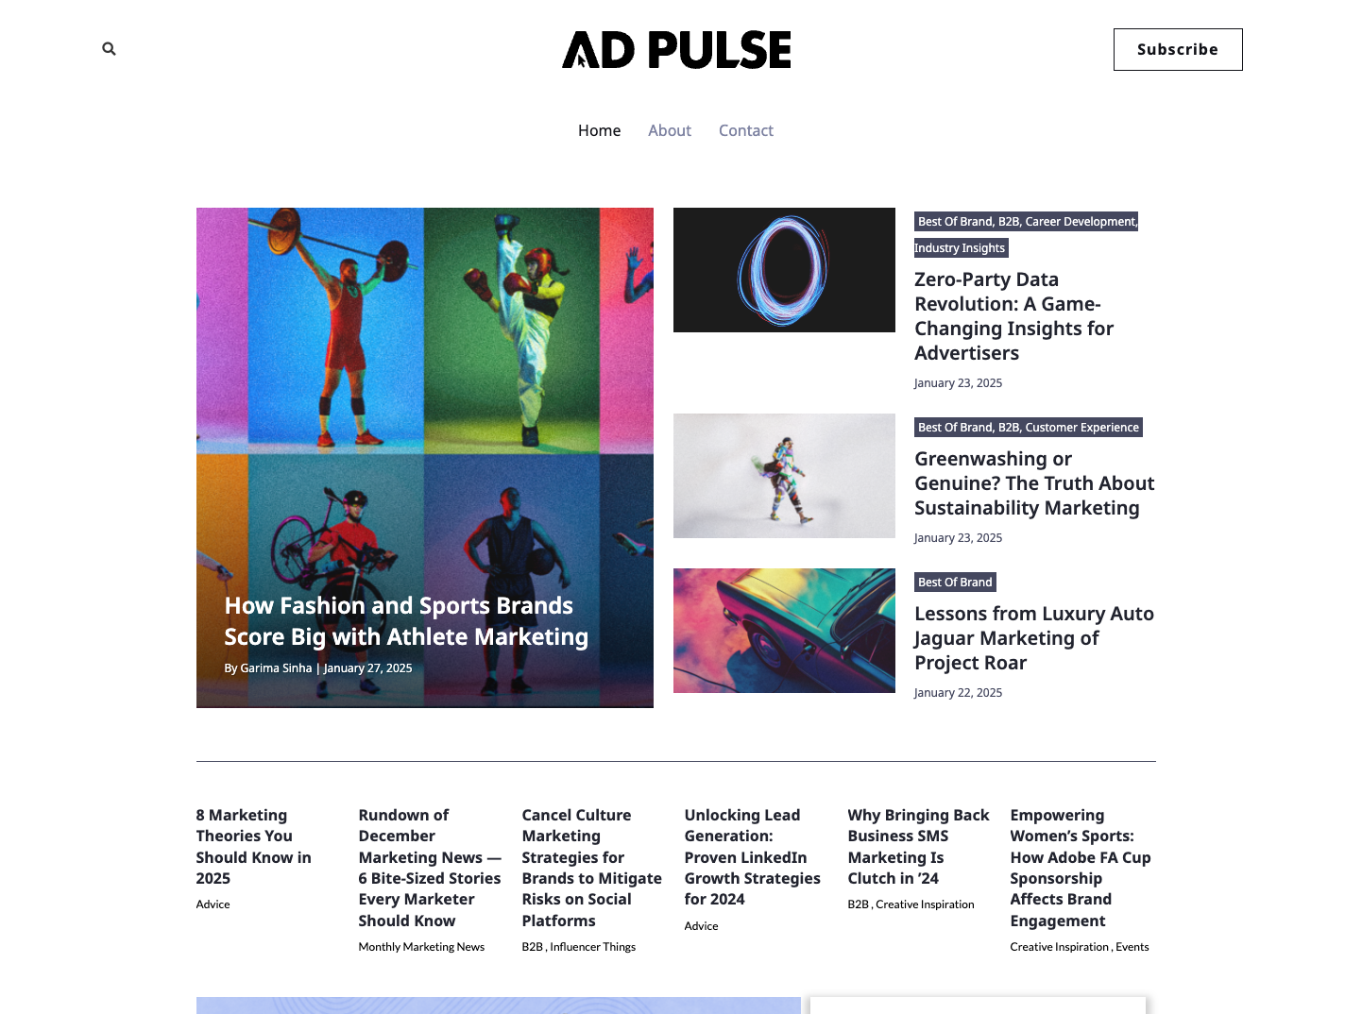
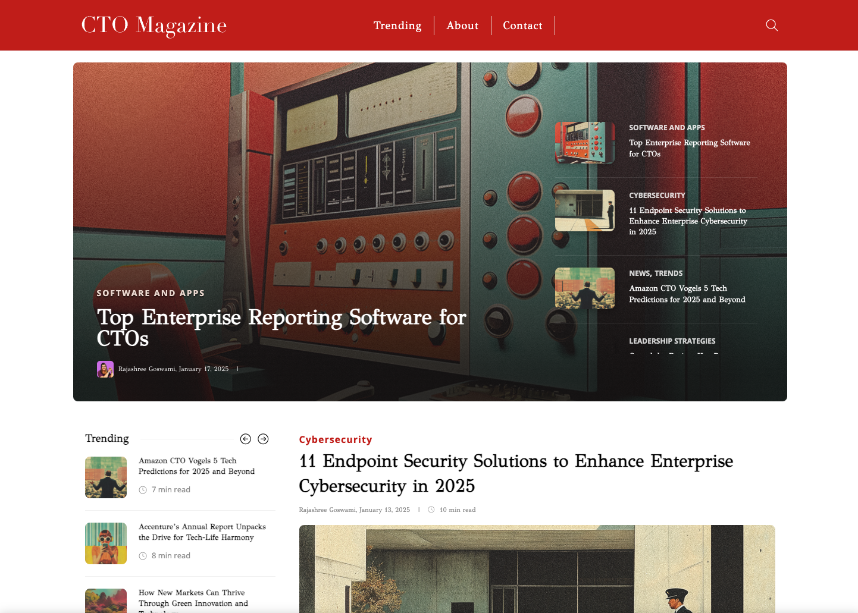
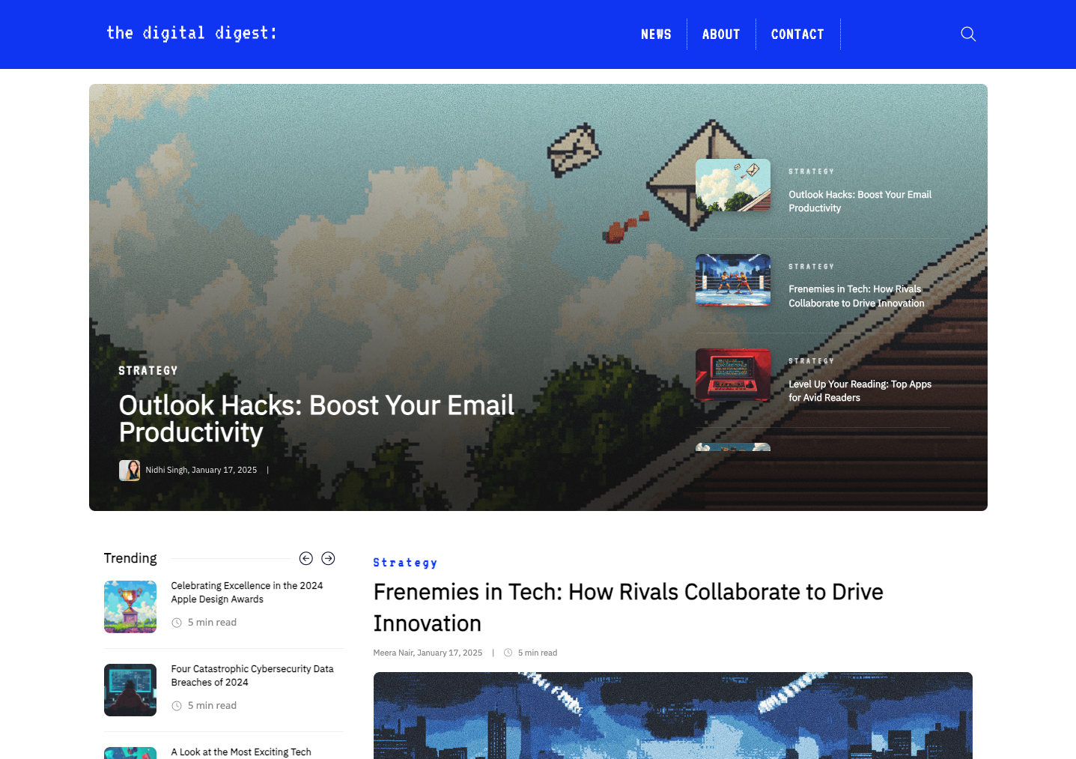






Editorial brands with impact.
The modern B2B buyer is choosing their own adventure and creating their own funnel. Our editors craft articles that inspire, meeting buying committees where they’re at, on their terms.
We know you.
Notes:
[The mission of this slide is to introdue our three publications and their explicitly targeted audiences.]
Scripting:
We didn’t create publications to chase clicks—we built them because we saw clear audience signals no one else was acting on.
With over 120 million B2B buyers in our database, we could see where the gaps were—and we built each brand to meet a distinct audience need.
CTO Magazine is for senior tech leaders shaping digital transformation.
Digital Digest speaks to the doers—IT pros who want practical, no-fluff insights.
Ad Pulse is where creative, modern, strategy-driven marketers go to stay sharp, connected, and ahead of trend.
Each brand was born from data, designed for engagement, and built to deliver content that buyers actually want.

Slide 4


11%
Explosive Audience Growth—Your Brand, Bigger Reach
CTO Magazine Created 2023
Ad Pulse
Created 2023
Digital Digest Created 2023
2023-2024
+26,000% PVs
2024-2025
+87%
PVs
2023-2024
+9,900% PVs
2024-2025
+200% PVs
2023-2024
+2,600% PVs
2024-2025
+125% PVs
Notes:
[The mission of this slide is to position our Pubs as new, growing infinitely, and dynamic.]
Scripting:
Let’s talk about scale. What you’re looking at here isn’t just growth—it’s explosive audience acceleration across our editorial brands. And that’s exactly the momentum your brand can plug into.
Starting with CTO Magazine—launched just last year, and already we saw a jaw-dropping +26,000% increase in page views from 2023 to 2024. And we didn’t plateau—we’re up another 87% this year, showing consistent upward trajectory among decision-makers in tech.
Ad Pulse, which we launched just in the second half of 2023, has followed suit—9,900% growth in year one, and now tracking +200% growth year-over-year. This is where tech-savvy marketing leaders are coming to stay informed.
And Digital Digest—our most data-driven brand focused on actionable IT insights—grew 2,600% in year one and continues to surge with a +125% increase this year.
Why does this matter to you? Your whitepapers, reports, and stories reach high-intent, highly engaged audiences across IT, marketing, and leadership.
Our growth is your opportunity. This is your moment to own the conversation—on platforms where your buyers already are.

Slide 5
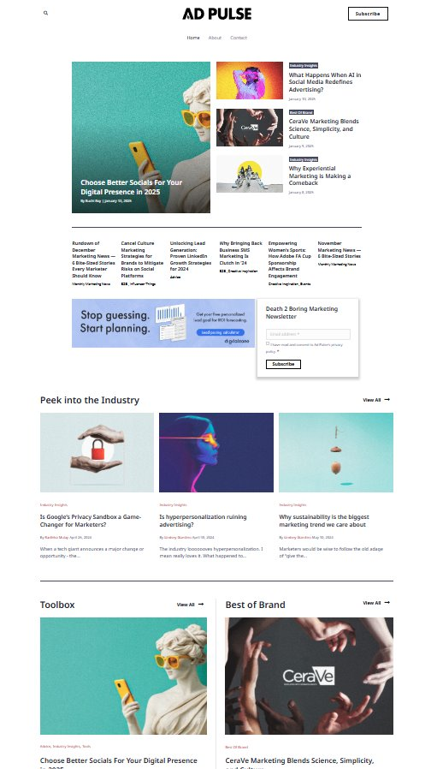
Ad Pulse
43%
Director and above subscribers
Audience Segments:
Client Marketers
  Brand
  Demand Gen
  CMO
Adtech/Martech
Agency professionals
  Creative
  Account
  Media
OUR EDITORIAL BRANDS
Tap into a bold, human-centered community of modern marketers.
The Ad Pulse community lives at the intersection of advertising, culture, creativity, and strategy — a curated audience of forward-thinking marketers plugged into the trends shaping today’s campaigns and tomorrow’s brands.
Relationships are key for our target reader. They value connections with peers, mentors, and clients, recognizing the power of networking in the competitive world of advertising. They seek out opportunities to collaborate, learn from others, and expand their professional circle.
Top topics: Campaign Inspiration, Marketing Industry Insights, DEI and Ethics, Customer engagement and experience, B2B marketing
Advertising with
Ad Pulse:
Brand-safe environment with a community built for and by marketers
Integrated storytelling that aligns with the tone and content of Ad Pulse
First-party reach with access to Digitalzone’s contact-level data and insights
Flexible formats for both awareness and demand-gen outcomes
Reporting that matters — from impressions to engagement to lead progression

Slide 6
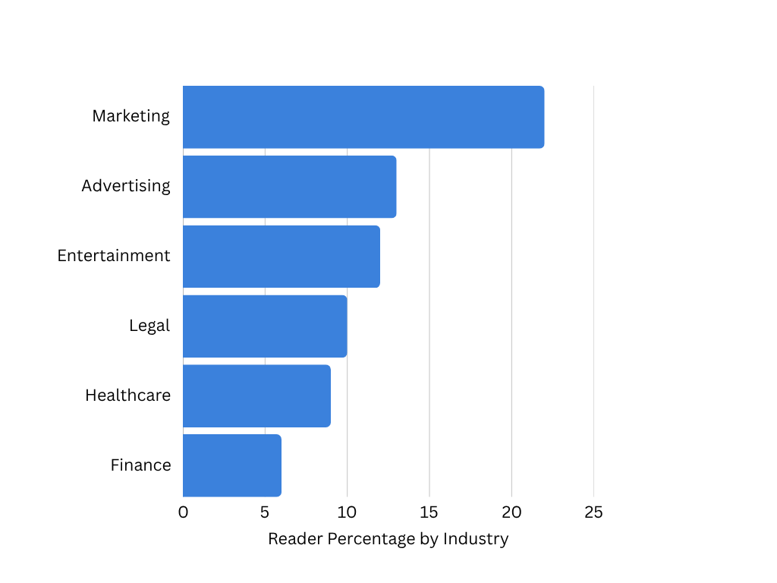
MEET OUR READERS
Tapping the Ad Pulse Audience
7%
14%
36%
29%
65%
25%
10%
North America
Europe
APAC
Notes:
[The mission of this slide is to differentiate our Data and explain introduce Pixel insights]
Scripting:
Most platforms talk about impressions. We talk about individuals.
Our data isn’t scraped, stitched, or secondhand. It’s first-party, contact-level intelligence. Every click, every pageview, every content interaction is tied to a real person with a verified identity. That means we’re not just tracking volume—we’re tracking who engaged, what they engaged with, and where they are in the funnel.
Data callouts:
Readers in marketing and advertising = 40% of our targeted audience.
We engage readers at every level of the funnel, every day. From startup staff to industry level VPs.
It’s that level of visibility that powers our Journey Pixel and our Insight Hubs. We can tell you which job title clicked your article, which company visited your collection, and who came back three times in one week.
It’s not just data. It’s buyer behavior, decoded—so you can act faster, nurture smarter, and convert with confidence.

Slide 7
Read by decision-makers across all industry sizes
<500
10K+
500-1K
5K-10K
1k-5K
Company Size by Employee Count
Company Size by Revenue
Notes:
[The mission of this slide is to differentiate our Data and explain introduce Pixel insights]
Scripting:
Here’s where it all comes together: we don’t just show you that someone engaged—we show you who they are and what they did.
With our Journey Pixel and contact-level reporting, you get visibility into the full content journey:
Name, company, job title, and email
What content they viewed
How many times they returned
And how far they moved through your funnel
We resolve 40%+ of site traffic to known identities, so you’re not working with anonymous signals—you’re tracking verified engagement.
And when you pair this with campaign reporting, this is real behavior. Real identity. And real fuel for your nurture and sales strategy.

Slide 8
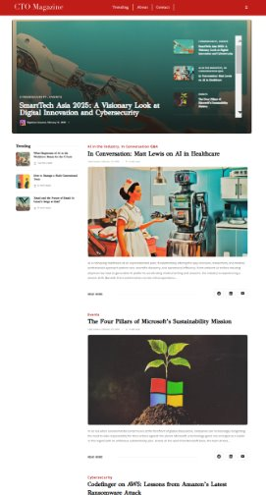
CTO Magazine
OUR EDITORIAL BRANDS
56%
Director and above subscribers
Audience Segments:
CTO/CIO
CISO
IT Director
Developer
Reach the minds shaping the future of technology.
CTO Magazine is where innovation meets insight — a publication that speaks directly to the leaders engineering the next era of digital transformation. This is more than just a magazine; it’s a narrative-driven platform built for CTOs, CIOs, and senior tech strategists who are as fluent in vision as they are in code.
Partners who advertise in CTO Magazine gain access to a deeply engaged audience that spans boardrooms, R&D labs, and everything in between. Every story, feature, and analysis is crafted to explore not just what’s next in tech — but what it means for business, society, and human experience.
Top topics: AI and Machine Learning, Advanced Tech, Cybersecurity, Leadership, Tech Ethics, Digital Architecture
Advertising with
CTO Magazine:
Premium tech audience of senior IT and innovation leaders
Credibility by association with respected editorial and analyst voices
Full-funnel impact — from thought leadership to pipeline acceleration
Contact-level engagement data through the Digitalzone Data Cloud
Highly customizable formats for awareness, education, or lead capture

Slide 9
MEET OUR READERS
Tapping the CTO Mag Audience
78%
10%
12%
North America
Europe
APAC
Notes:
[The mission of this slide is to differentiate our Data and explain introduce Pixel insights]
Scripting:
Most platforms talk about impressions. We talk about individuals.
Our data isn’t scraped, stitched, or secondhand. It’s first-party, contact-level intelligence. Every click, every pageview, every content interaction is tied to a real person with a verified identity. That means we’re not just tracking volume—we’re tracking who engaged, what they engaged with, and where they are in the funnel.
Data callouts:
Readers in marketing and advertising = 40% of our targeted audience.
We engage readers at every level of the funnel, every day. From startup staff to industry level VPs.
It’s that level of visibility that powers our Journey Pixel and our Insight Hubs. We can tell you which job title clicked your article, which company visited your collection, and who came back three times in one week.
It’s not just data. It’s buyer behavior, decoded—so you can act faster, nurture smarter, and convert with confidence.

Slide 10
Read by decision-makers across all industry sizes
10K+
<500
5K-10K
500-1K
1k-5K
Company Size by Employee Count
Company Size by Revenue
Notes:
[The mission of this slide is to differentiate our Data and explain introduce Pixel insights]
Scripting:
Here’s where it all comes together: we don’t just show you that someone engaged—we show you who they are and what they did.
With our Journey Pixel and contact-level reporting, you get visibility into the full content journey:
Name, company, job title, and email
What content they viewed
How many times they returned
And how far they moved through your funnel
We resolve 40%+ of site traffic to known identities, so you’re not working with anonymous signals—you’re tracking verified engagement.
And when you pair this with campaign reporting, this is real behavior. Real identity. And real fuel for your nurture and sales strategy.

Slide 11
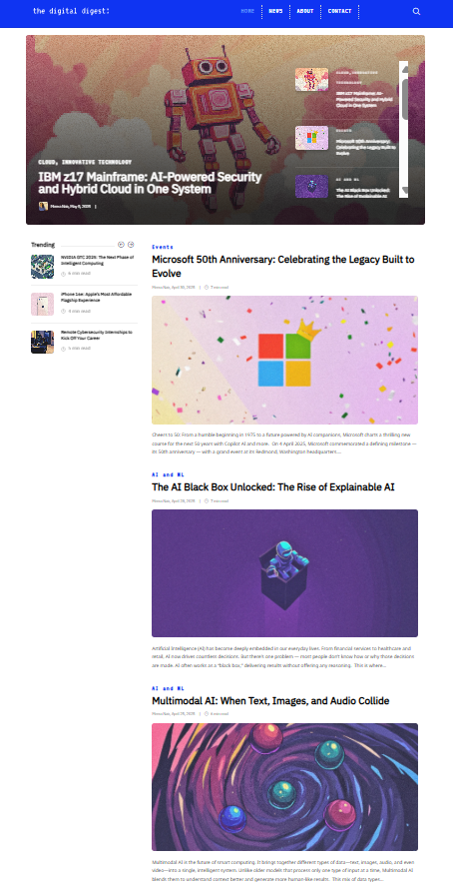
Digital Digest
62%
Manager
and practitioners
Audience Segments:
IT Professionals
Tech Enthusiasts
Intellectually Curious
Tech Influencers
OUR EDITORIAL BRANDS
No fluff. Just insight that moves the needle.
Digital Digest is the go-to destination for tech professionals who need fast, clear, and pragmatic insights to drive real business outcomes. It’s a publication built for doers, not theorists — delivering unfiltered commentary, real-world application, and sharp takes on the tech trends that matter most.
By advertising in Digital Digest, your partners gain direct access to decision-makers and practitioners looking for tools, strategies, and solutions they can put into action today. It’s an ideal platform for messaging that’s rooted in clarity, utility, and impact — no jargon, no fluff, just results.
Top topics: IT Community, Digital Security, Innovative Technology, Digital Strategy, Software and Apps
Advertising with
Digital Digest:
High-velocity audience looking for solutions, not sales pitches
Tone that aligns with real-world practitioners and decision-makers
First-party reporting with full contact-level transparency
Built for impact — use it for brand awareness, education, or demand-gen goals
Co-branded content options to align your partner’s expertise with real insights

Slide 12
MEET OUR READERS
Tapping the CTO Mag Audience
50%
44%
6%
North America
Europe
APAC
Notes:
[The mission of this slide is to differentiate our Data and explain introduce Pixel insights]
Scripting:
Most platforms talk about impressions. We talk about individuals.
Our data isn’t scraped, stitched, or secondhand. It’s first-party, contact-level intelligence. Every click, every pageview, every content interaction is tied to a real person with a verified identity. That means we’re not just tracking volume—we’re tracking who engaged, what they engaged with, and where they are in the funnel.
Data callouts:
Readers in marketing and advertising = 40% of our targeted audience.
We engage readers at every level of the funnel, every day. From startup staff to industry level VPs.
It’s that level of visibility that powers our Journey Pixel and our Insight Hubs. We can tell you which job title clicked your article, which company visited your collection, and who came back three times in one week.
It’s not just data. It’s buyer behavior, decoded—so you can act faster, nurture smarter, and convert with confidence.

Slide 13
Read by decision-makers across all industry sizes
10K+
<500
5K-10K
500-1K
1k-5K
Company Size by Employee Count
Company Size by Revenue
Notes:
[The mission of this slide is to differentiate our Data and explain introduce Pixel insights]
Scripting:
Here’s where it all comes together: we don’t just show you that someone engaged—we show you who they are and what they did.
With our Journey Pixel and contact-level reporting, you get visibility into the full content journey:
Name, company, job title, and email
What content they viewed
How many times they returned
And how far they moved through your funnel
We resolve 40%+ of site traffic to known identities, so you’re not working with anonymous signals—you’re tracking verified engagement.
And when you pair this with campaign reporting, this is real behavior. Real identity. And real fuel for your nurture and sales strategy.

Slide 14


Product Offering: Insight Hub

Slide 15
Insights Hub
Where partner stories meet editorial authority.
Insights Hubs are fully co-branded storytelling environments hosted within Digitalzone’s global publication network, including Ad Pulse, CTO Magazine, and Digital Digest. These dynamic microsites are built to engage your audience through a curated journey of thought leadership, product narratives, and demand gen content — all contextualized within the editorial voice your audience already trusts.
Every Insights Hub is a 100% partner-owned experience — blending brand storytelling with the creative power of our editorial and design teams to move audiences from discovery to action.
Advantages
Built-in credibility by aligning with trusted global publications
Multi-asset storytelling with clear progression from awareness to conversion
Award-winning creative and insights-driven design included
Editorial collaboration to guide message tone and structure
Full transparency with user-level tracking and reporting
Deliverables
Guaranteed leads model. No surprises and full budget control.
One fully co-branded Insight Hub hosted on a publication aligned to your target audience
12+ curated partner content assets
Co-branded Hub with intro copy, gated content modules, and journey-based layout
Multi-channel promotion via multi-channel distribution
Journey Reporting and optimization recommendations
Notes:
[The mission of this slide is to introduce our Insight Hub.]
Scripting:
So here’s the difference when you invest in an Insight Hub or a brand-to-demand campaign with us: we don’t just push content out and hope it lands. We start by digging into who you’re actually trying to reach.
Work backwards from your ICP: We look at what your ideal buyers are already engaging with on our network—the topics they care about, the articles they’re clicking on—and then our editorial team builds a strategy around that audience.
Our team are trained journalists with integrity: It’s not just a content dump—it’s a guided experience. We want your articles to be clickable, sure. But more than that, we want people to stick around. To click into one piece, then another, and start really connecting with your brand.
Contact-level insights: And because we’ve got the Journey Pixel running in the background, we’re tracking all of that behavior. We’re constantly watching what’s getting attention and what’s not—so we can keep optimizing and adjusting to keep the right people engaged.
Sometimes that means someone lands on a thought leadership piece… then ends up on an article comparing the top five demand gen providers—and hey, your brand’s right there. That’s how we help guide the journey, naturally. And the best part? With our Journey Reporting, we can show you exactly where someone is in the funnel based on the content they’re engaging with. Real insights, not just pageviews.

Slide 16
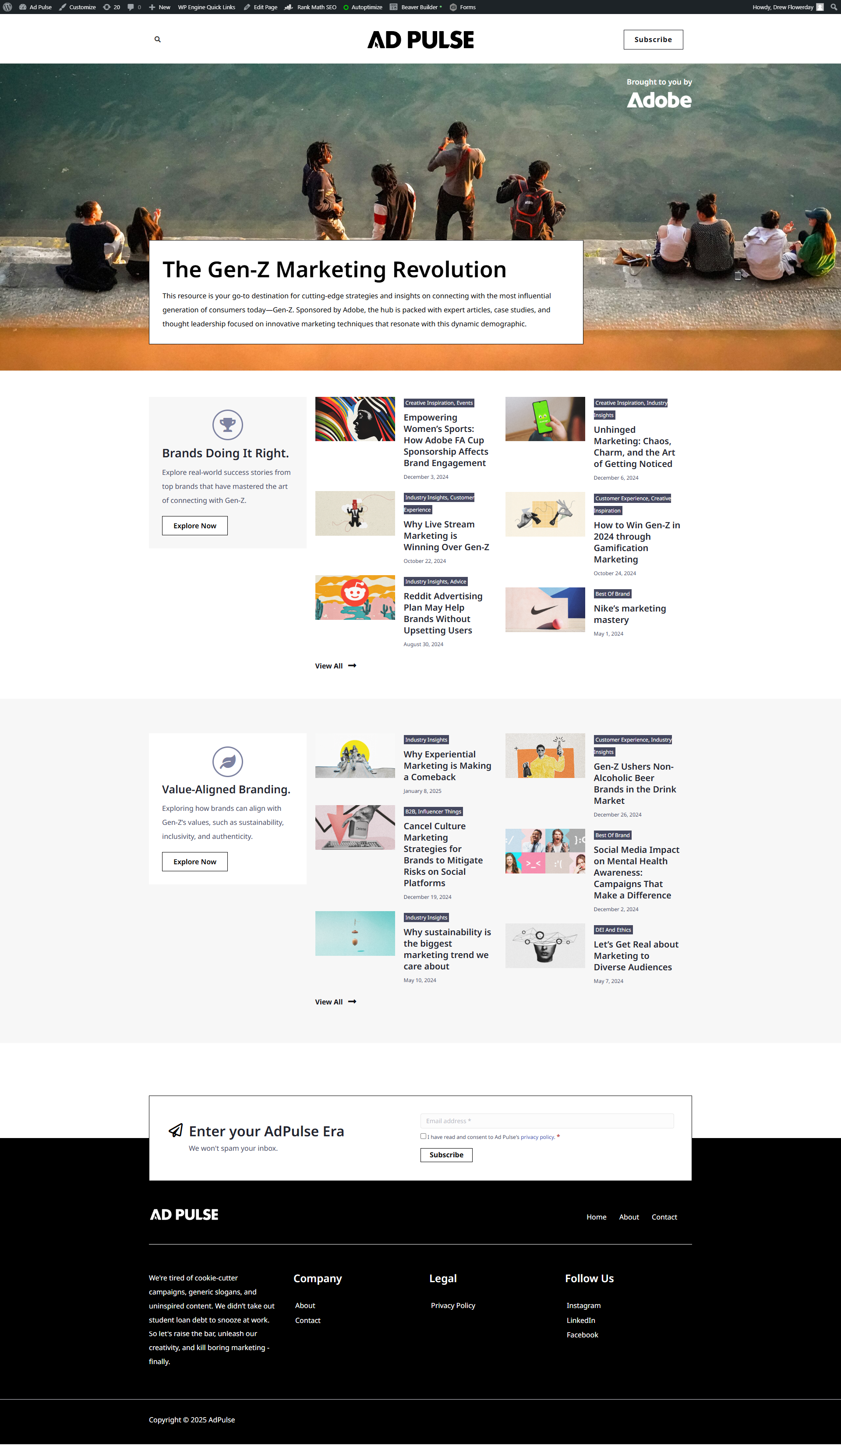
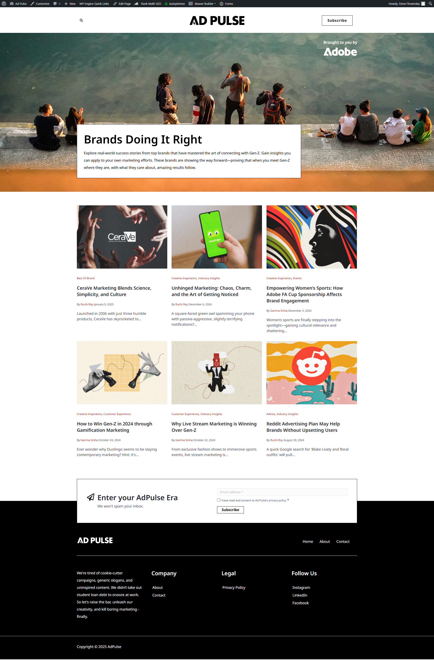
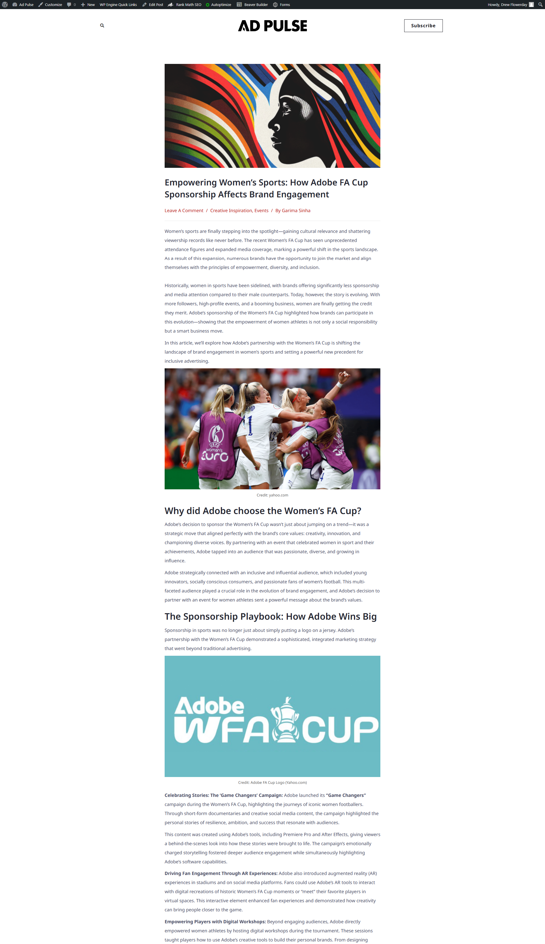
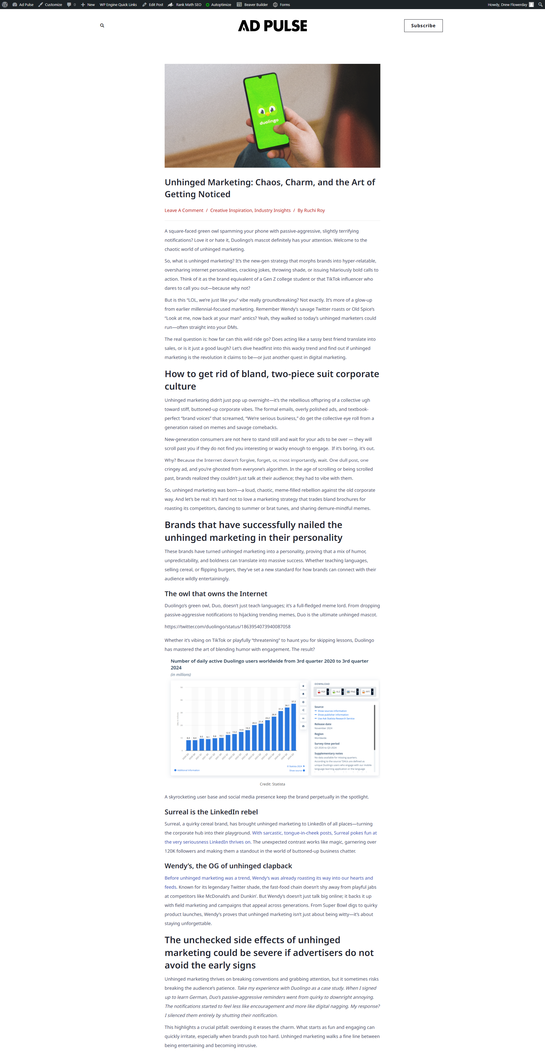
Telling your content story
MAIN PAGE
COLLECTIONS
CONTENT PAGES
The Insights Hub is a dynamic storytelling experience – compelling and nurturing your target audience with relevant content from brand awareness to demand generation.
The Digitalzone team collaborates with you and our Editorial staff to strategically bring your brand story to life through:
Award-winning creative
Insights-driven design
Strategic messaging
100% ownable experience
Your main page introduces the topical collection with an overview of what the content will empower audiences to learn.
Collections feature sponsored content that follows a logical sequence, guiding users down a content journey.
Individual content pages track user engagement and promote additional content to drive multi-asset engagement.
Notes:
[The mission of this slide is to explain our Insight Hub process.]
Scripting:
So what does this actually look like in practice?
Once you’re in, we kick things off with a collaborative planning phase. You bring your existing content—videos, whitepapers, whatever you’ve got—and we pair that with our editorial insight and creative direction.
We’ll align on themes, messaging, and audience priorities. Our team writes any custom content needed, based on your briefs and goals. You’ll review drafts, give feedback, and we’ll make sure everything sounds and looks the way it should.
Then, we build out the full Insight Hub—co-branded, beautifully designed, and structured to guide readers through a clear journey. It’s a hands-on, collaborative process—but one that’s built to be seamless. You bring the expertise, we bring the editorial and the engine.
We we operate with cross-functional teams that can pivot quickly, and real-time analytics loops that shape our targeting.
Main Page: https://adpulse.com/adobe-gen-z-marketing-revolution/
Collection 1: https://adpulse.com/adobe-gen-z-marketing-revolution/brands-doing-it-right/
Collection 2: https://adpulse.com/adobe-gen-z-marketing-revolution/value-aligned-branding/

Slide 17
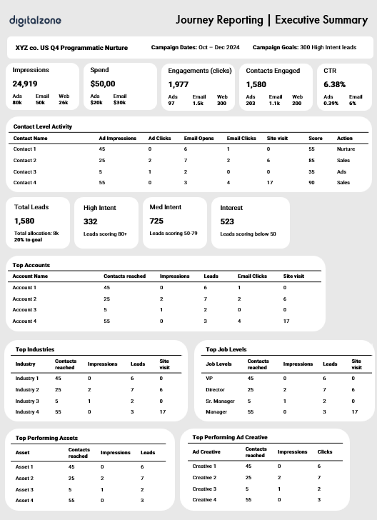
The Insights Hub audience experience
ENGAGEMENT
DEMAND GENERATION
Co-branded thought leadership and contact-level traffic visibility with the Journey Pixel.
Lead generation via content syndication and Digitalzone Journey Reporting.
Brand awareness
Multi-channel brand amplification.
Contact-level Precision Targeting display: Media impressions to drive traffic to related content pieces.
Subscriber-based editorial sponsorships: Newsletter and browser notifications drives traffic to related content pieces.
Contextual and account targeting social: Paid and organic social media drives traffic to related content pieces.
Remarketing Digital Digest visitors: Media advertising nurtures previous site traffic, driving them to further content consumption
Notes:
When you partner with us, we build an Insight Hub tailored to your ideal customer profile (ICP). Using real-time behavioral data from our Publications, we reverse-engineer your hub around the content your buyers are already engaging with. Everything is built to keep your ICP exploring and moving down the funnel, from curated articles and thought leadership to demand-driving assets.

Slide 18


Unmatched contact-level visibility
Insight Hub gives you access to contact-level insights that drive real engagement, not just impressions. With AI-verified targeting across global B2B subscribers, plus visibility into every content touchpoint, campaign activity, and site visit.
40%+
Identity resolution rate across pageviews and Display engagement
Asset(s) engagement
Engagement Score
# Asset engagement
Emails clicked
# Email clicks
Ad creative(s) seen
# Ad impressions
6x
More engagement across digital touchpoints with Contact-Level Precision Targeting
Website Page(s) viewed
# Site visits
Ad creative(s) clicked
Name
# Ad clicks
Publication article(s) viewed
Company
# articles viewed
Emails opened
Job Title
We help you deliver better qualified leads and prove joint ROI faster.
# Email opens
Email

Slide 19


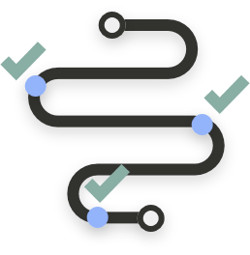
Journey Reporting with Ad Pulse
Unified multi-channel campaign reporting with built-in engagement scoring for clearer intent signals, higher quality leads, and true brand-to-demand visibility.
All the ABM reporting you’re used to plus visibility into the contact-level micro-journeys across Expert Corner page visitors and leads.
Engagement Score
Name
# Asset engagement
Asset(s) engagement
Company
# Ad impressions
Ad creative(s) seen
Job Title
# Ad clicks
Ad creative(s) clicked
Email
# Email opens
Emails opened
# Email clicks
Emails clicked
# Site visits
Page(s) viewed

Slide 20

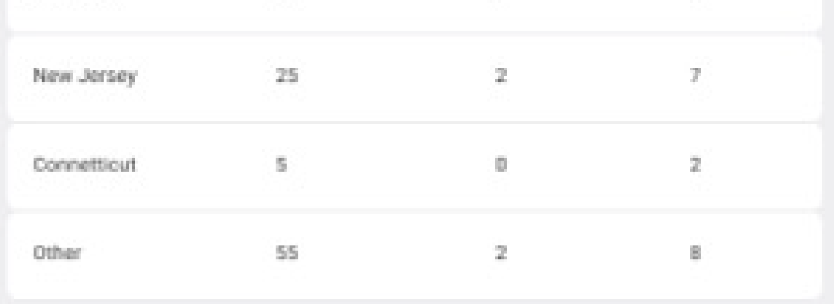
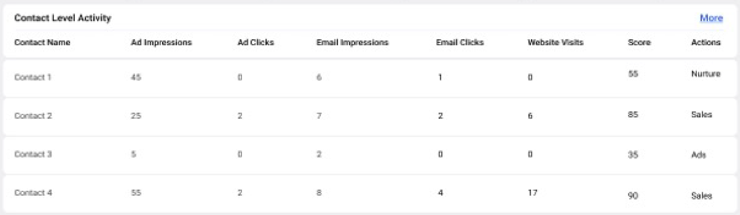
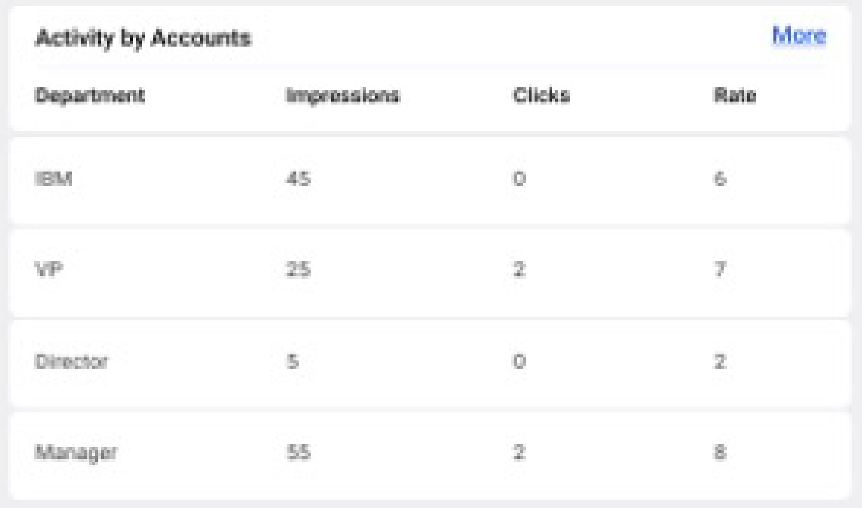
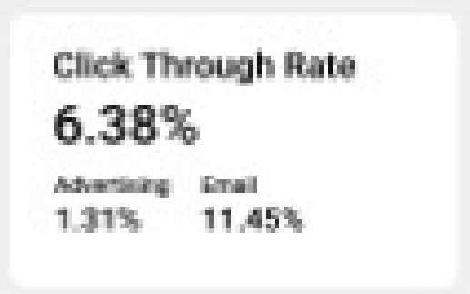
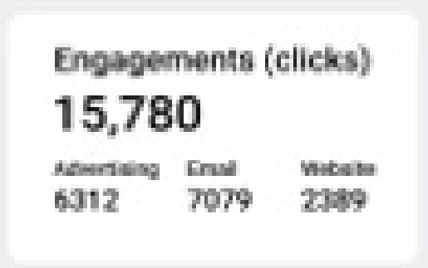
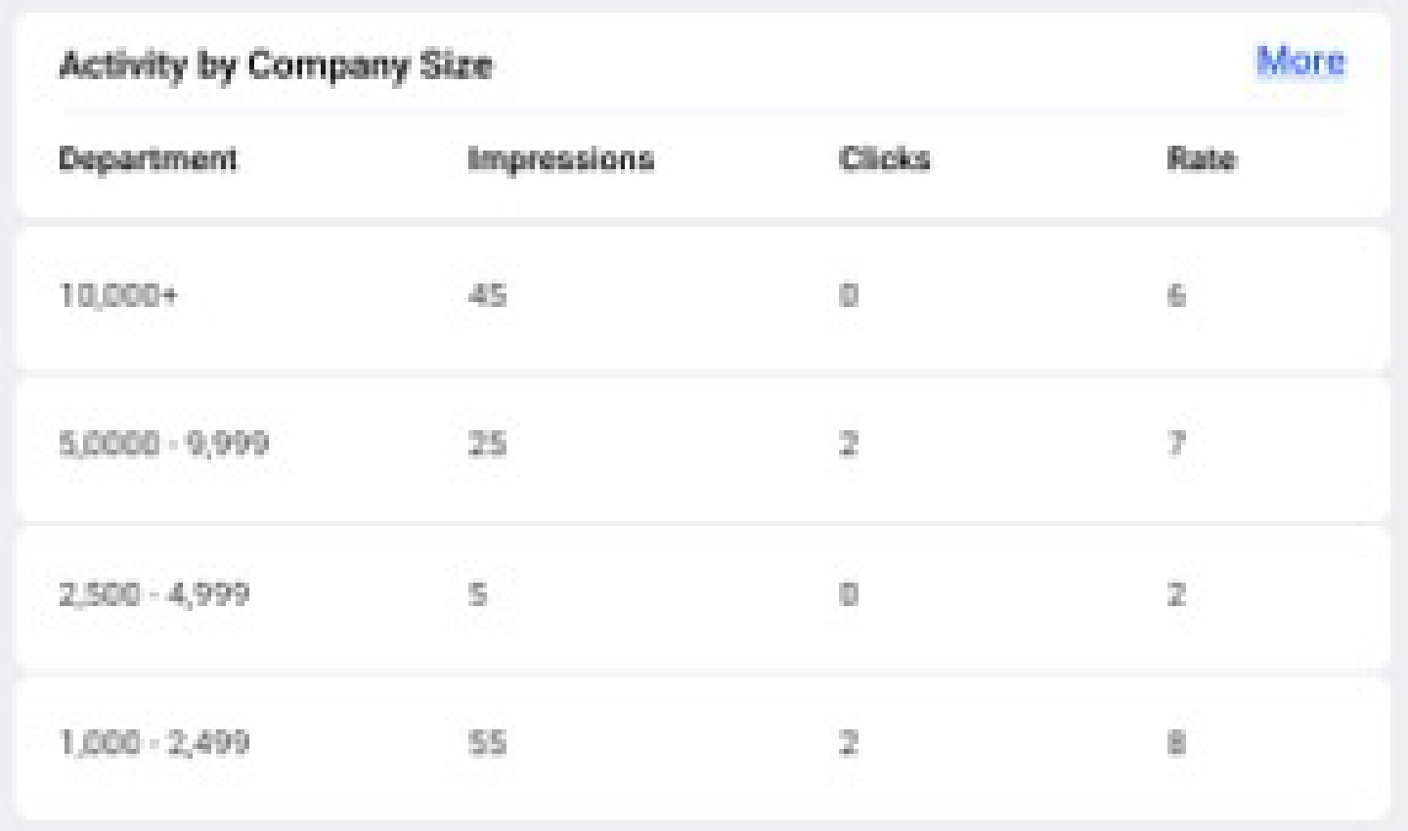
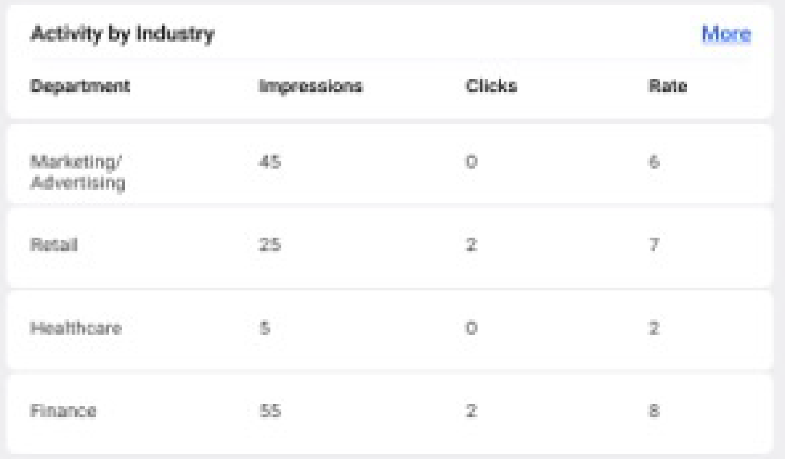
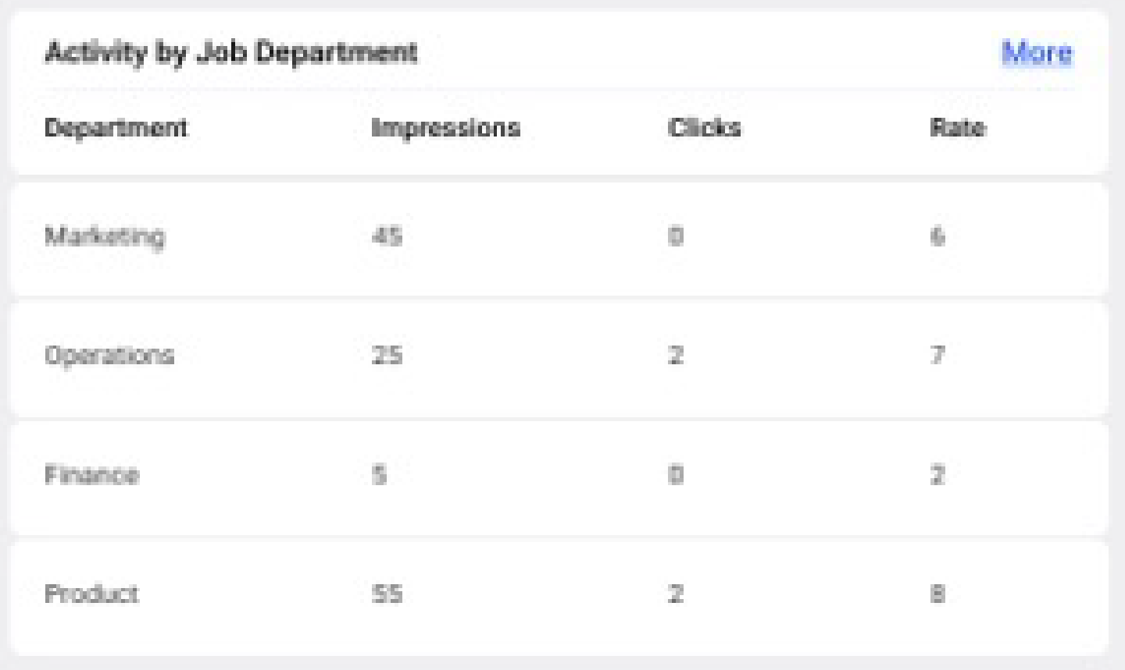
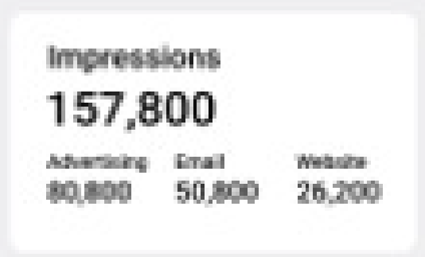
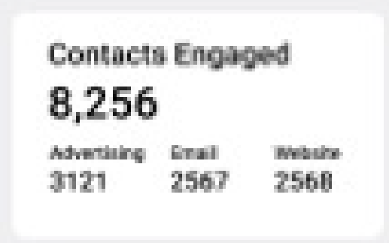
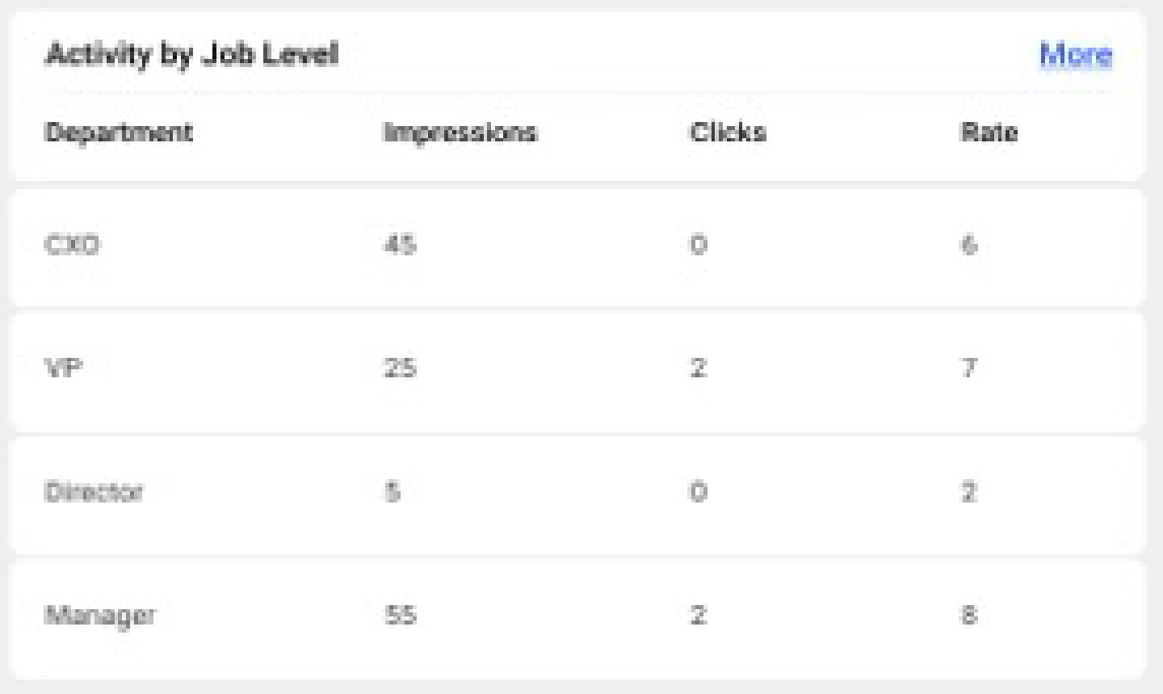
Delivering lead journey transparency
Our integrated brand-to-demand campaigns, supercharged by the Journey Pixel, allow us to deliver connected identity resolution across the entire user journey for the most relevant lead experience and more accurate lead qualification.
We’re committed to a zero-waste demand generation philosophy. Delivering seamless brand experiences and being more where it matters.
More agile. More personalized. More strategic. Zero waste.
First-party reach
Contact-level targeting throughout your program for relevant messaging.
Media attribution
A clearer picture of media impact on revenue.
Contact-level reporting
Visibility into the account and contact-level data for insights-driven nurture.
Unveiled site visits
Move site visitors from unknown to known at the contact-level.
Contact-level reporting across:
Editorial Insight Hub
Display & Video Ads
Email nurture

Slide 21





Insights Hub Process
Week 0:
Pubs + client finalize themes, content briefs, and all supporting ancillary materials
Week 1:
All internal stakeholders review master plan to ensure it is meeting expectations and is complete
Pubs writers are assigned content
Week 3:
Author edits are reflected in the copy with tracking
Double check visuals and callouts
The majority of revisions to the manuscript are expected during his first draft review.
Week 4:
Content is ready for final client review
Week 5:
Graphic design and layout is complete and ready for review
Once final approval is received from the client, the files are ready for publication and distribution
External Kickoff
Supply Phase
Internal Kickoff
Content Drafts
Client Review of Drafts
Content Edits
Client Review of Second Draft
Draft Submitted to Layout
Client Final Proof Review
CONTENT LOCKED
Week 0:
Your team supplies
Graphics, design, + ad info
Editorial Style Guide
In-house content pieces
Week 1-2:
Pubs team writes content according to briefs.
Week 3-4:
Content is revised according to client feedback.
No further content edits without associated costs added
All author queries are addressed, and files are cleaned up, finalized, and proofread
Files are then sent to layout and design

Slide 22



How it works
Timing
Production:
4-6 weeks
In-market duration:
6 months
A brand-to-demand experience with Insights Hub
Create
Content
Readers Engage
Digitalzone Delivers
Deliverables
Includes:
40,000 page views Content refresh
2,000 leads
6 million promotional impressions
Select one (1) Digitalzone B2B publication site to host your Expert Corner on.
Up to (10) articles supplied by client and (10) assets developed by Digitalzone:
    (6) 800-word articles
    (2) Research-based articles
    (2) 5-page eBooks
20,000 guaranteed pageviews on content
3 million contextually relevant and targeted promotional impressions
Precision remarketing advertising
Journey Reporting across every digital touchpoint.
1,000 guaranteed leads via content syndication and page promotion

Slide 23


Other products that we offer

Slide 24

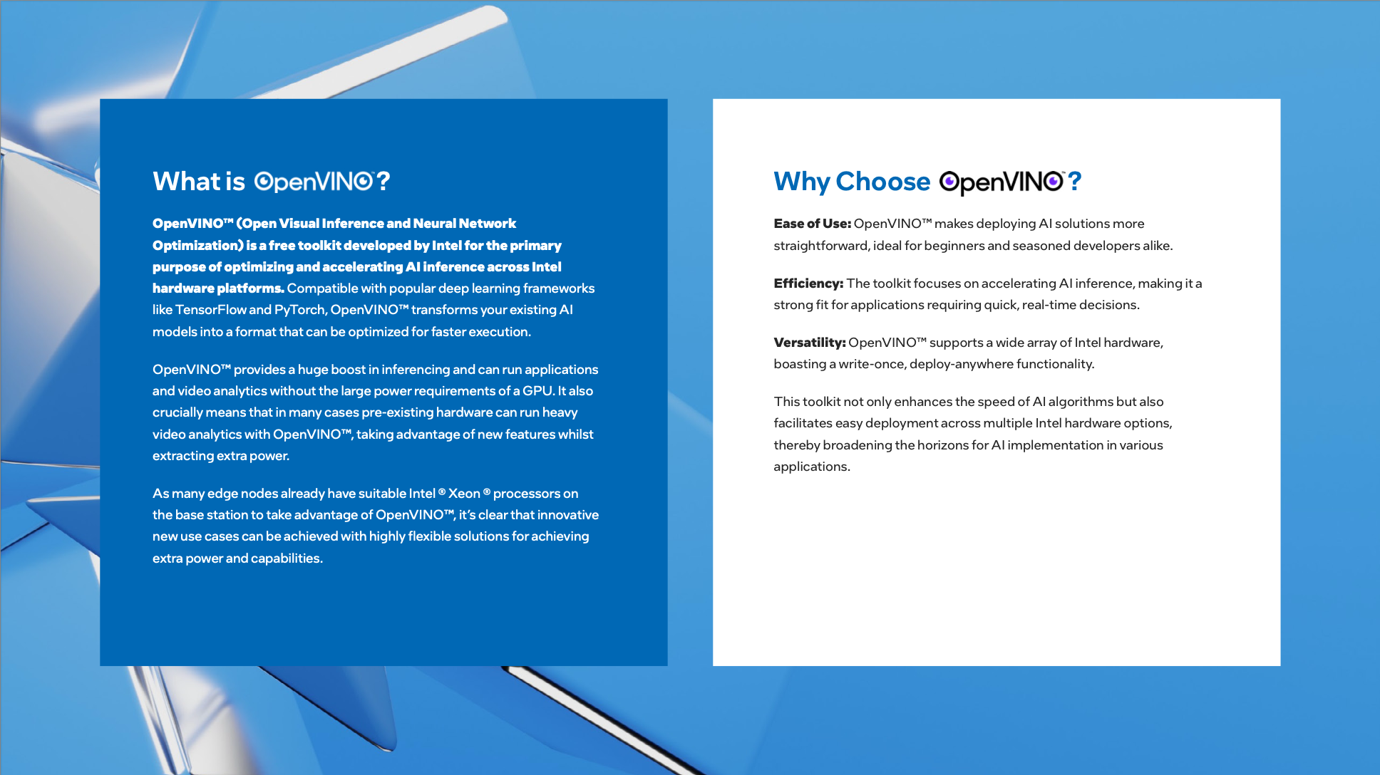
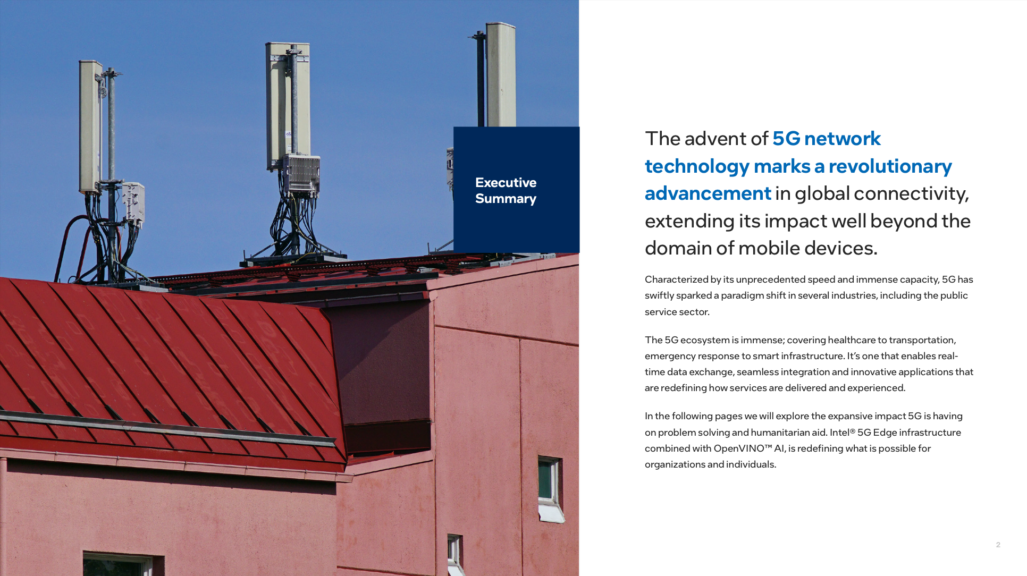
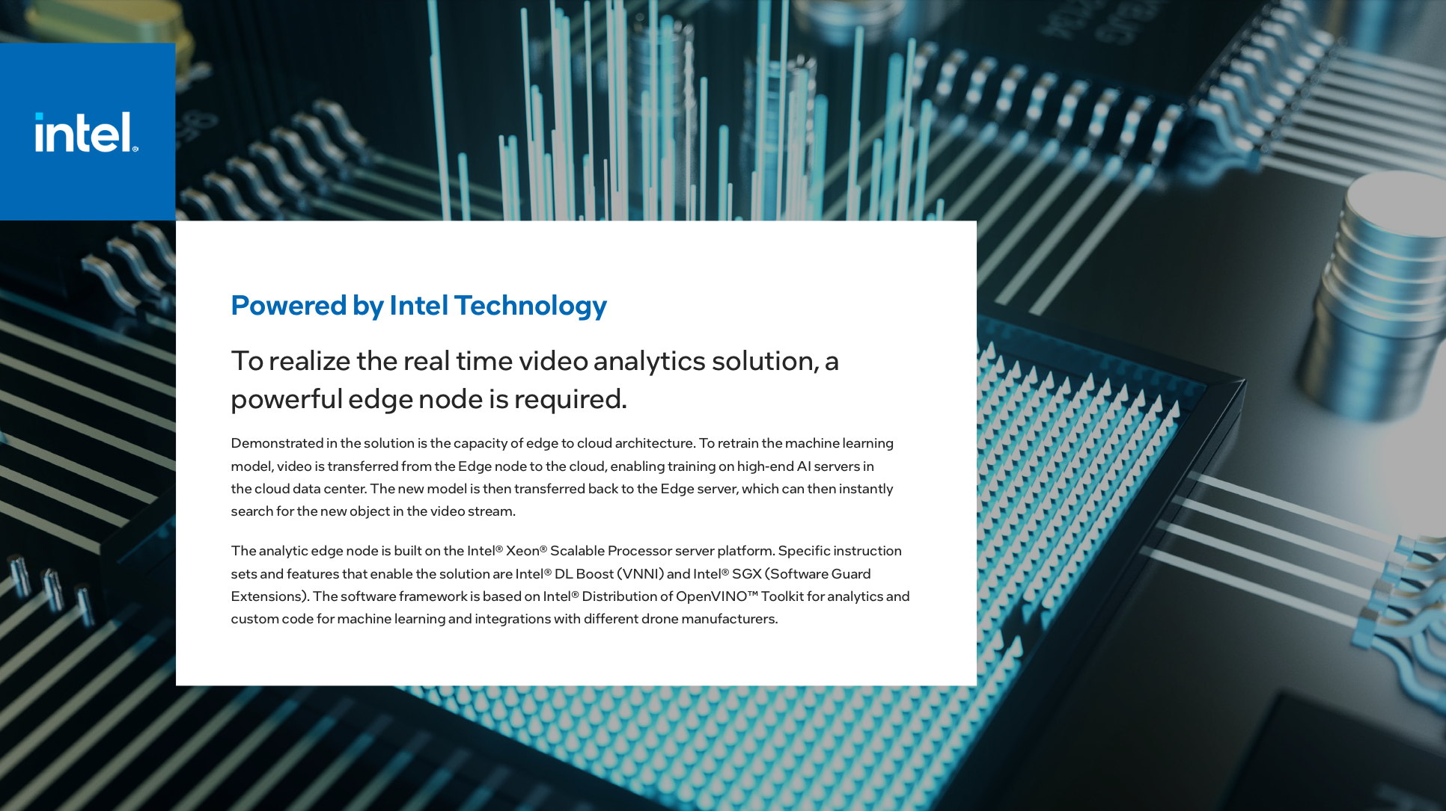
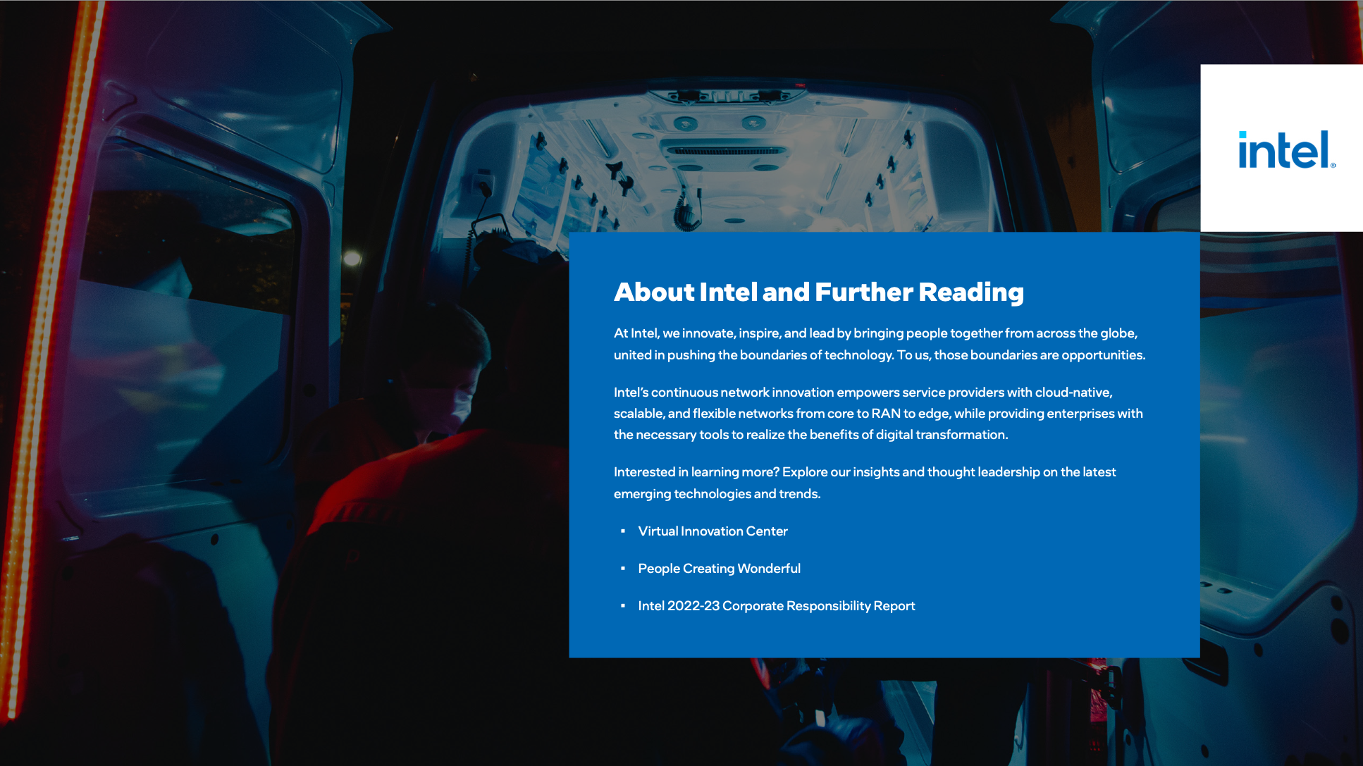
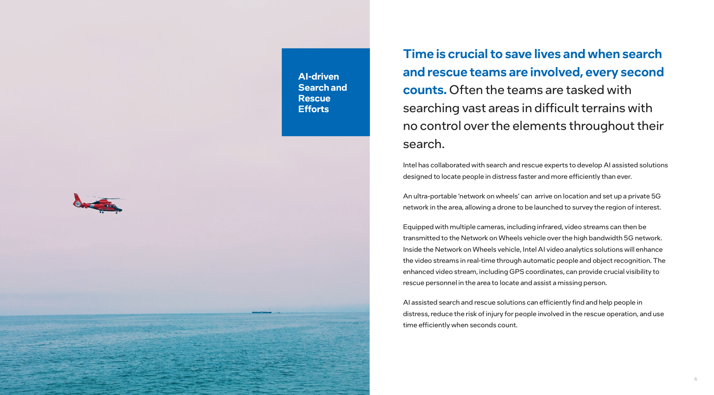
Content Creation
OTHER PRODUCTS WE OFFER
Creating and optimizing content for your lead generation campaigns can often come with a hefty time investment.
We know our global community well, so we know what content will move the needle in your favor. We work closely with our clients to develop effective, highly-relevant content that leverages insights from our proprietary database.
Co-created content to drive thought leadership goals, or optimize the content you have for better converting campaigns:
Distribution of content across Digitalzone channels:
Content syndication
Display and video ads
Email Nurture
Channel services
eBooks
Whitepapers
Webinars
Infographics
Articles
One-pagers
Case studies
Video

Slide 25

Contact Us
Whether you're here to explore an insight hub, contribute an article, spark partnerships, or finally find content that resonates with your audience—you're in the right place.
Kassidy Svenson
Associate Director, Publications
Kassidy@digitalzone.com

Slide 26
Thank you.

